Slide 1

The Spring Framework
A quick overview

Slide 2
The Spring Framework
Spring principles: IoC
Spring principles: AOP
A handful of services
A MVC framework
Conclusion

Slide 3
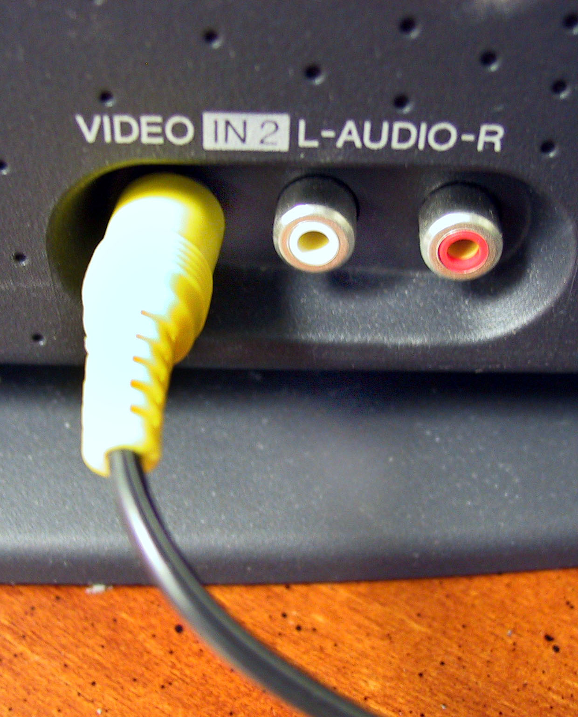
1. Spring principles: IoC
Inversion of Control: an object interacts with its environment
Objects are « plugged » one in another
The environment is set up by the container instead of the object itself

Slide 4
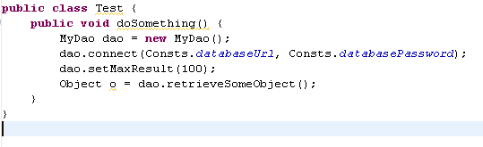
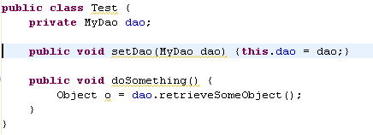
1. Spring principles: IoC
Without IoC:
With IoC

Slide 5
1. Spring principles: IoC
Useful for separating dao and business layer
Useful for separating controllers and business layer
The code is more extensible, easier to read, and modules/layers can easily be replaced

Slide 6

2. Spring principles: AOP
Separates the core business code from the aspects we wrap around it: security, transaction management, …
Through AOP, we add transversal functionalities to objects (ie not directly related to the code it contains)

Slide 7
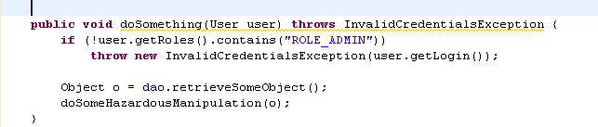
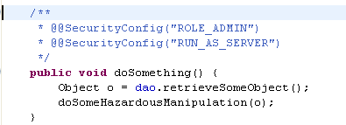
2. Spring principles: AOP
Without AOP
With AOP

Slide 8
2. Spring principles: AOP
Useful for automatic handling of transaction with Hibernate
Useful for Acegi (automatic credentials checking before executing some methods)
Code smaller, easier to read (not polluted by transversal aspects not directly relevant)

Slide 9
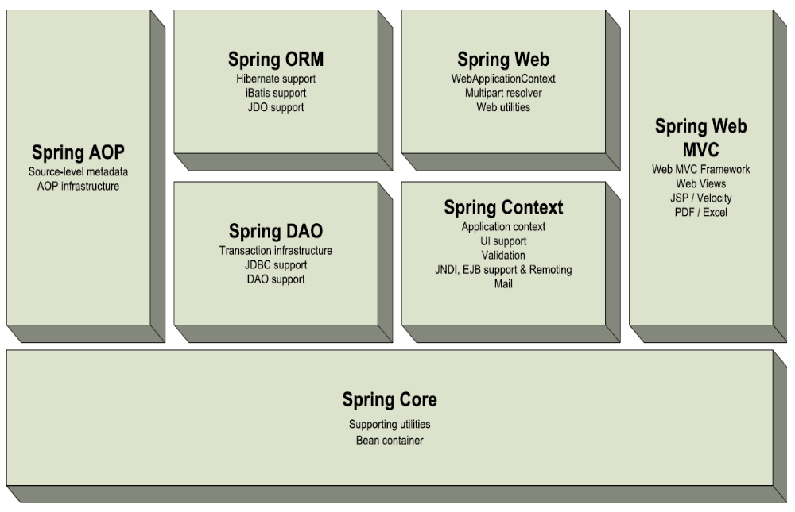
3. A handful of services

Slide 10
3. A handful of services
DAO support: Spring offers templates classes to deal with a Hibernate/JDBC/… connection
Exception translator: all the proprietary Hibernate/JDBC/… exceptions are catched by Spring, and rethrown as Runtime non-specific consistent exceptions
Hence the DAO code is not dependant on the underlying datasource!

Slide 11
3. A handful of services
Many ORM tools are supported: Hibernate, JDO, Apache OJB, iBATIS
Templates using IoC to reduce the amount of code in the DAO objects

Slide 12
3. A handful of services
Support of RMI
Very easy to expose and connect to webservices
Support of JMS
JMS templates, JMSException translation

Slide 13
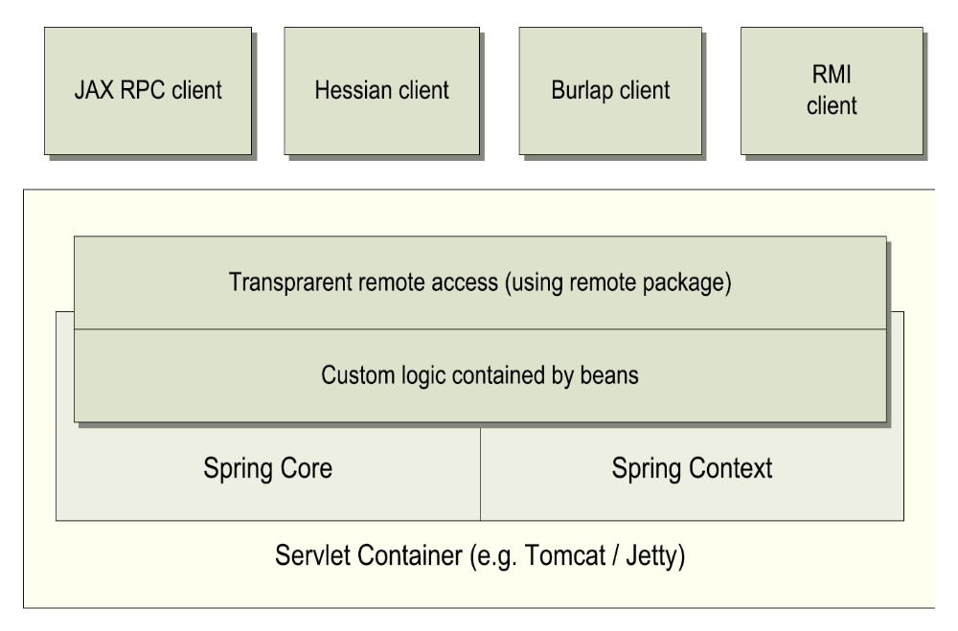
3. A handful of services

Slide 14


3. A handful of services
A mail abstraction layer
  Templates
Jobs scheduling (Quartz, Timer)
  Cron
  Business layer unaware

Slide 15
4. A full MVC Framework
Clear separation of roles: controller, validator, form object, Dispatch servlet, View resolver, …
Extensible and adaptable
Several views of a result (pdf, excel, html, …)
Can be wired (possible to use transparently the IoC pattern)

Slide 16
4. A full MVC Framework
Can be used with other frameworks: JSF, Struts, Tapestry, Webwork
Completely transparent: no need to change anything in what is done by these other frameworks

Slide 17
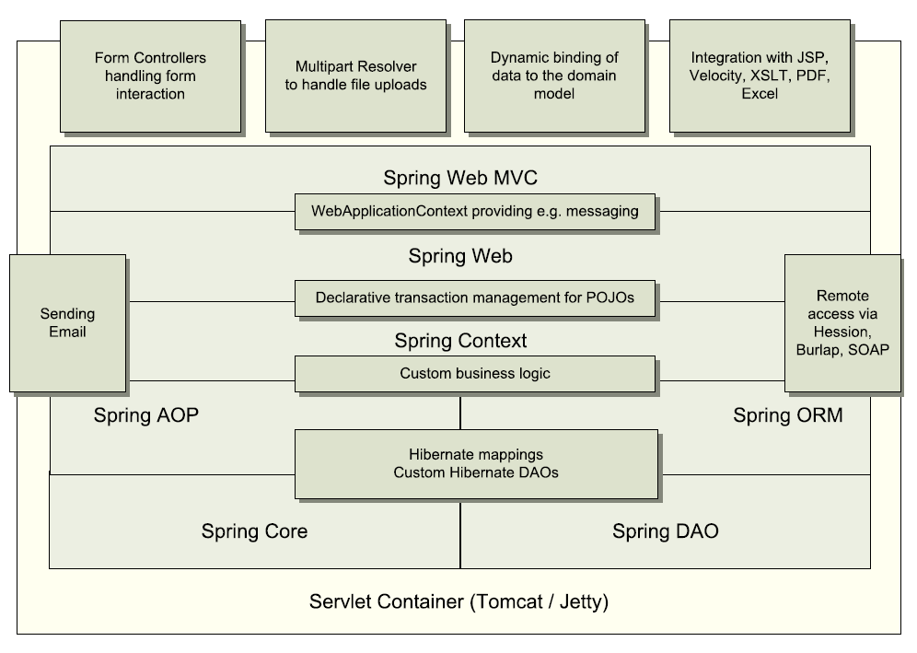
4. A full MVC Framework

Slide 18
5. Conclusion
Learning curve
XML configuration & annotations
Tiny
Open-source and free
Active development
Linked with several important Java projects (Hibernate, Acegi, …)

